Slide 1
Just a Trim
A management game set in a barber shop by two dudes that have never had a haircut.
Team: The Hairy Indies
Title: Just a Trim
Genre: Management
Audience: Hairy dudes aged 18 - 24
Target Release: TBD
Platforms: iOS & Android (possibly steam / itch.io)

Slide 2
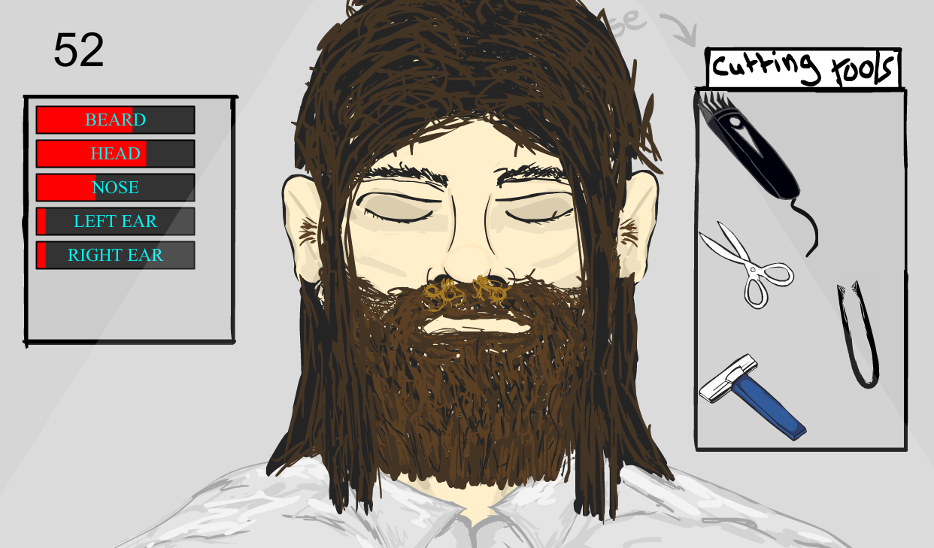
Initial Goal
Like the original, but polished to perfection.
Random faces? – Put the random faces on hold at the moment. This might not be needed.
Random hair styles/colours?

Slide 3
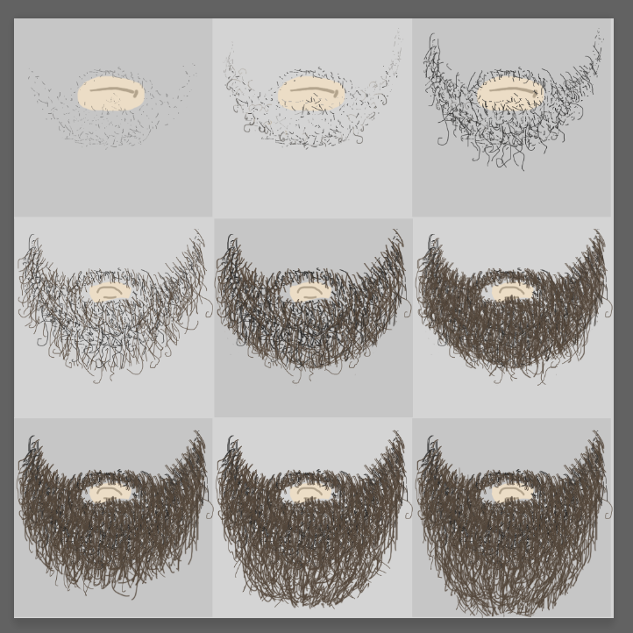
Sprite Atlas
Sprite atlas need to be limited to a square 1024px by 1024px to be optimised for mobile devices.
We may need to compress all sprite atlas’ down to 512px by 512px for lower end Android devices.
From my limited understanding there’s a way of checking which device the user is running on and if it’s a shitty one then it compresses sprites and reduces particle counts to run smoother on the fly. (might be tricky to do though!)
I might try lots of cleaner variations of the beard style.

Slide 4
Art Specification
If we use particles, keep particle counts relatively low.
Be wary of draw call when animating.

Slide 5
Design
Push in a weird sense of humour, embrace the madness!
It doesn’t have to make sense because the gag / hook is that it’s being made by two dudes that have never been to a barber shop. Similar approach to this!

Slide 6
Second to Second Experience
Do you think there needs to be transitions between states changing in hair growth? For example a simple fade in at 0.1 seconds of the next beard state.

